Slide 1
Algorithmic State Machine (ASM) Chart
The function of a state machine (or sequential circuit) can be represented by a state table or a state diagram.
An Algorithmic State Machine (ASM) is simply a flowchart-like way to specify state diagrams for sequential logic .

Slide 2
ASM Primitives
State Box
(a rectangle)
Decision Box
(a diamond)
Vector Decision Box
(a hexagon)
Conditional Output Box
(oval).
The State Box is a rectangle, marked with the symbolic state name and contains the output signals.
The Scalar Decision Box is a diamond that describes the effects of a specific input condition on the control. It has one input path and two exit paths, one for TRUE (1) and one for FALSE (0).
The Vector Decision Box is a hexagon that describes the effects of a specific n-bit (n > 2) vector of input conditions on the control.
The Conditional Output Box is an oval with entry from a decision block and outputs activated for the decision conditions being satisfied.

Slide 3
Traffic Light Controller Example
A busy highway is intersected by a little used farm-road. Detectors C sense the presence of cars waiting on the farm-road. With no car on farm-road, light remain green in highway direction. If vehicle on farm-road, highway lights go from Green to Yellow to Red, allowing the farm-road lights to become green. These stay green only as long as a farm-road car is detected but never longer than a set interval. When these are met, farm lights transition from Green to Yellow to Red, allowing highway to return to green.
Assume you have an interval timer that generates a short time pulse
(TS) and a long time pulse (TL). TS is to be used for timing yellow lights and TL for green lights.

Slide 4
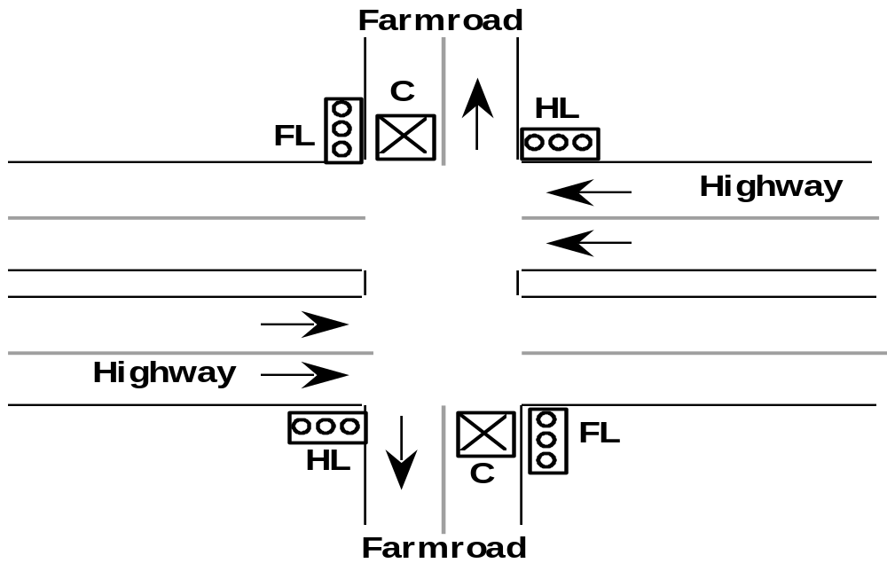
Traffic Light Controller

Slide 5
Traffic Light Controller Example
Tabulation of input and output
Input Signal
reset
C
TS
TL
Output Signal
HG, HY, HR
FG, FY, FR
Description
place FSM in initial state
detect vehicle on farm-road
short time interval expired
long time interval expired
Description
assert green/yellow/red highway lights
assert green/yellow/red farm-road lights

Slide 6
Traffic Light Controller Example
Tabulation of Unique States: Some light configuration imply others
State
S0
S1
S2
S3
Description
Highway green (farm-road red)
Highway yellow (farm-road red)
Farm-road green (highway red)
Farm-road yellow (highway red)

